Slide 1

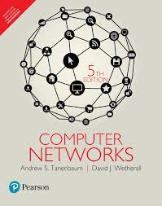
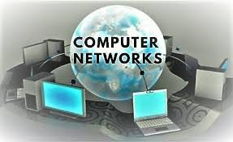
COMPUTER NETWORKS
Dr. U. SRILAKSHMI
Asst. Professor
Dept. of CSE
VFSTR

Slide 2
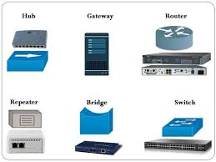
NETWORK HARDWARE
Dr. UPPALAPATI SRILAKSHMI, Asst. Professor, Dept. of CSE, VFSTR Deemed to be University, E-mail: usl_cse@vignan.ac.in

Slide 3
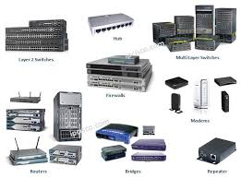
INTRODUCTION
When we refer to network hardware we are talking about a range of electronic devices that can be interconnected in such a way as to allow the transmission of communication signals between a number of workstations.
These devices range from simple generic hubs to sophisticated proprietary hardware such as routers and gateways.
To help you gain a better understanding of how these devices interact with each other you need knowledge of what devices are available and how they work.
The following represents some of the more commonly used network hardware components.
Dr. UPPALAPATI SRILAKSHMI, Asst. Professor, Dept. of CSE, VFSTR Deemed to be University, E-mail: usl_cse@vignan.ac.in

Slide 4

NETWORK HARDWARE
Network
Interface
Cards (NIC)
Switches
Routers
Modems
Hubs
Bridges
Gateways
Dr. UPPALAPATI SRILAKSHMI, Asst. Professor, Dept. of CSE, VFSTR Deemed to be University, E-mail: usl_cse@vignan.ac.in

Slide 5
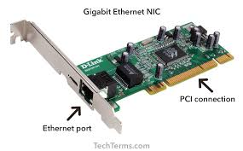
Network Interface Cards (NIC)
Network Interface Cards (NICs) are the most common type of network hardware on a network.
Every workstation and server will contain at least one NIC.
NICs contain the electronic components that establish and control network communications.
The NIC is the principal hardware device that differentiates between a networked computer and a stand-alone computer.
Dr. UPPALAPATI SRILAKSHMI, Asst. Professor, Dept. of CSE, VFSTR Deemed to be University, E-mail: usl_cse@vignan.ac.in

Slide 6
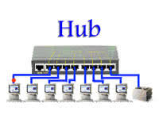
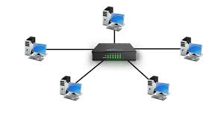
HUBS
Hubs have no intelligence, meaning they cannot be programmed or have a memory of devices that are plugged into its ports.
They are quite suitable for small networks but tend to perform poorly on large networks.
Hubs typically come in both standard (10 Mbps) and Fast Ethernet (100 Mbps) versions.
Dr. UPPALAPATI SRILAKSHMI, Asst. Professor, Dept. of CSE, VFSTR Deemed to be University, E-mail: usl_cse@vignan.ac.in

Slide 7
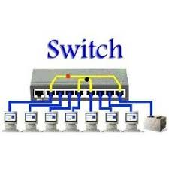
Switches
Switches look nearly identical to hubs, but a switch generally contains more ‘intelligence’ than a hub.
Unlike hubs, network switches are capable of inspecting the data packets as they are received, determining the source and destination device of that packet, and forwarding that packet appropriately.
By delivering messages only to the connected device that it was intended for, network switches conserve network bandwidth and offer generally better performance than hubs.
Most switches are active: that is, they electrically amplify the signal as it moves from one device to another.
Dr. UPPALAPATI SRILAKSHMI, Asst. Professor, Dept. of CSE, VFSTR Deemed to be University, E-mail: usl_cse@vignan.ac.in

Slide 8
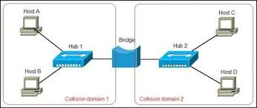
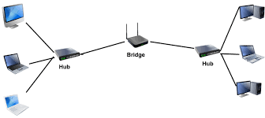
Bridges
Bridges are devices that allow you to segment a large network into two small, more efficient networks.
If you are adding an older wiring scheme and want the new network to be up-to-date, a bridge can connect the two.
A bridge monitors the information traffic on both sides of the network so that it can pass packets of information to the correct location.
Most bridges can ‘listen’ to the network and automatically figure out the address of each computer on both sides of the bridge.
The bridge can inspect each message and, if necessary, broadcast it on the other side of the network.
Bridges manage the traffic to maintain optimum performance on both sides of the network.
Bridges can be used to connect different types of cabling as long as both networks are using the same protocol.
Dr. UPPALAPATI SRILAKSHMI, Asst. Professor, Dept. of CSE, VFSTR Deemed to be University, E-mail: usl_cse@vignan.ac.in

Slide 9
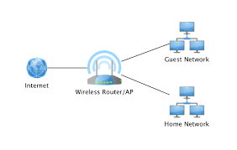
Routers
Routers translate information from one network to another; it is similar to a bridge with extra intelligence.
Routers select the best path to route a message, based on the destination address and origin.
The router can direct traffic to prevent head-on collisions, and is smart enough to know when to direct traffic along back roads and shortcuts.
While bridges know the addresses of all computers on each side of the network, routers know the addresses of computers, bridges, and other routers on the network.
Routers can even ‘listen’ to the entire network to determine which sections are busiest - they can then redirect data around those sections until they clear up
Dr. UPPALAPATI SRILAKSHMI, Asst. Professor, Dept. of CSE, VFSTR Deemed to be University, E-mail: usl_cse@vignan.ac.in

Slide 10
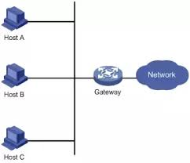
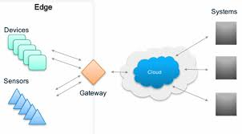
Gateways
Gateways are able to connect networks that use completely different protocols or data formats, such as a LAN to a mainframe.
Generally a gateway is a combination of hardware and software with the built-in processing power necessary to perform protocol conversions.
A gateway is slower than a bridge or router.
Dr. UPPALAPATI SRILAKSHMI, Asst. Professor, Dept. of CSE, VFSTR Deemed to be University, E-mail: usl_cse@vignan.ac.in

Slide 11
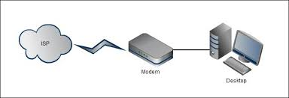
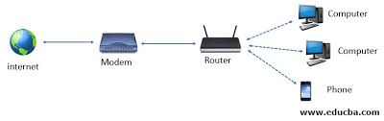
Modems
Modems (Modulator Demodulator) convert data between the analogue form used on telephone lines and the digital form used on computers.
ADSL modems (also called ADSL routers) are used on many networks to provide the required connectivity to the Internet.
These modems typically have a reasonable level of intelligence and are capable of performing a number of advanced networking features including DHCP and Firewall services.
ADSL modems are a popular choice for connecting small- to medium-size organizational networks to the Internet using an established ISP.
Dr. UPPALAPATI SRILAKSHMI, Asst. Professor, Dept. of CSE, VFSTR Deemed to be University, E-mail: usl_cse@vignan.ac.in

Slide 12
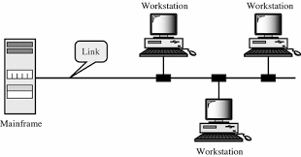
There are two types of transmission technology:
Broadcast Networks: This has a single communication channel that is shared by all the machines on the network.
The data transmitted is converted in small packets form.
Each packet contains address field of the destination station.
Ex:- a person standing at corridor “watson, come here. I want you”
Sending same packets to all the stations within a network is called as broadcasting.
When data packets are sent to a specific group of stations it is called as multicasting. This is a selective process
Dr. UPPALAPATI SRILAKSHMI, Asst. Professor, Dept. of CSE, VFSTR Deemed to be University, E-mail: usl_cse@vignan.ac.in

Slide 13
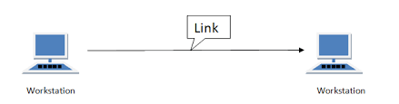
2. Point-to-point Network: Point-to-point connections use an actual length of wire or cable to connect the two ends, but other options, such as microwave or satellite links, are also possible.
When you change television channels by infrared remote control, you are establishing a point-to- point connection between the remote control and the television's control system.
This network provides a dedicated link between any two stations . Such a transmission is called unicasting.
Dr. UPPALAPATI SRILAKSHMI, Asst. Professor, Dept. of CSE, VFSTR Deemed to be University, E-mail: usl_cse@vignan.ac.in

Slide 14
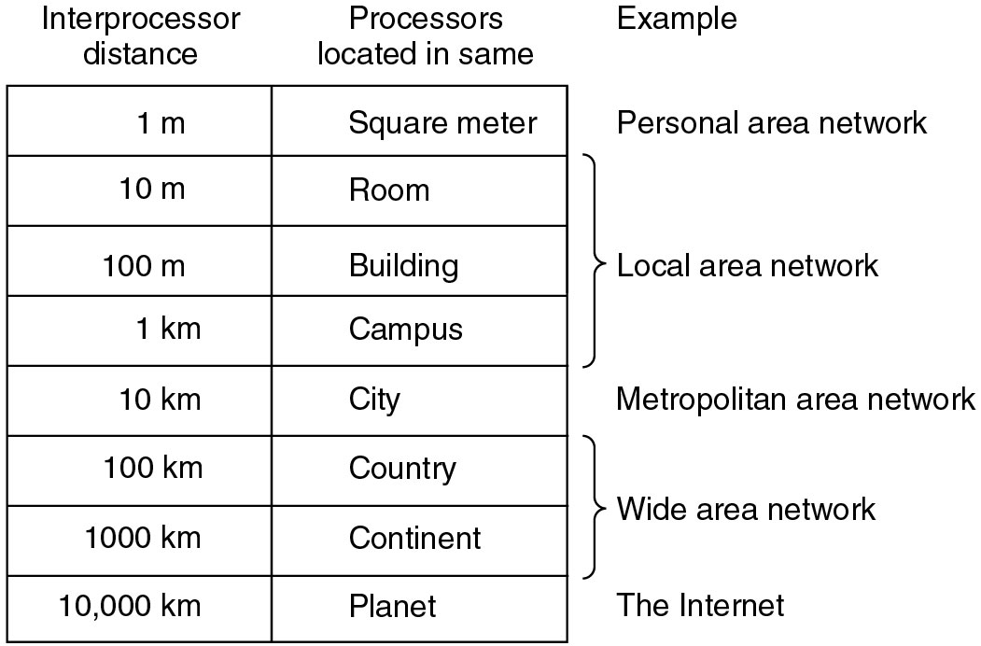
Personal area network is sending a message over a very short distance
Computers that communicate by exchanging messages over longer cables. LAN, MAN and WAN
The connection of two or more networks is called an internetwork.
Classification of interconnected processors by scale
Dr. UPPALAPATI SRILAKSHMI, Asst. Professor, Dept. of CSE, VFSTR Deemed to be University, E-mail: usl_cse@vignan.ac.in

Slide 15


TYPES OF NETWORK
Local Area Networks
Wide Area Networks
Home Networks
Internetworks
Metropolitan Area Networks
Wireless Networks
Dr. UPPALAPATI SRILAKSHMI, Asst. Professor, Dept. of CSE, VFSTR Deemed to be University, E-mail: usl_cse@vignan.ac.in

Slide 16
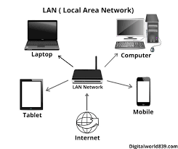
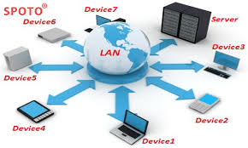
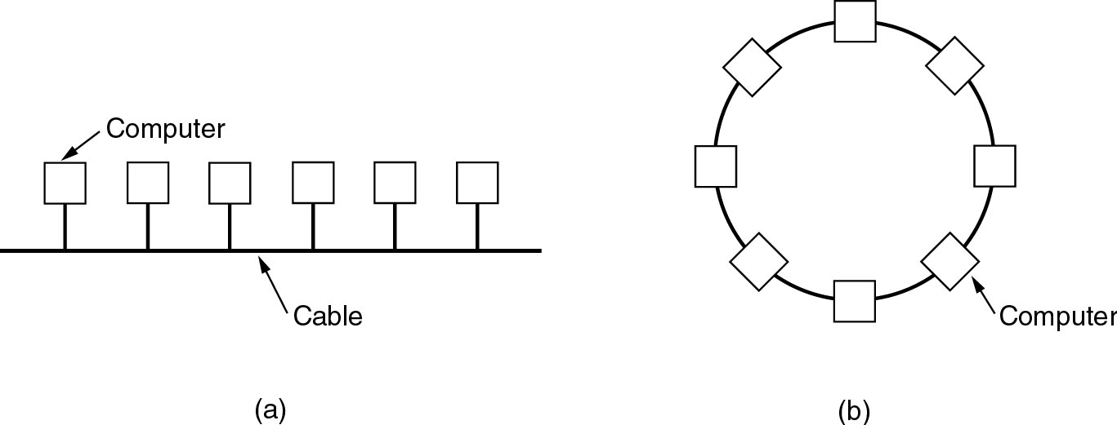
Local Area Network
Dr. UPPALAPATI SRILAKSHMI, Asst. Professor, Dept. of CSE, VFSTR Deemed to be University, E-mail: usl_cse@vignan.ac.in

Slide 17
LANS are privately-owned networks within a single building or campus of up to few kilometers in size.
LANS are distinguished based on
– Their size
– Their transmission technology
– Their topology
LANS are restricted in size
LANS use a transmission technology consisting of a single cable to which all machines are attached like telephone company lines once used in rural areas.
LANS run at speeds of 10 to 100 Mbps, have low delay and make very few errors.
Dr. UPPALAPATI SRILAKSHMI, Asst. Professor, Dept. of CSE, VFSTR Deemed to be University, E-mail: usl_cse@vignan.ac.in

Slide 18
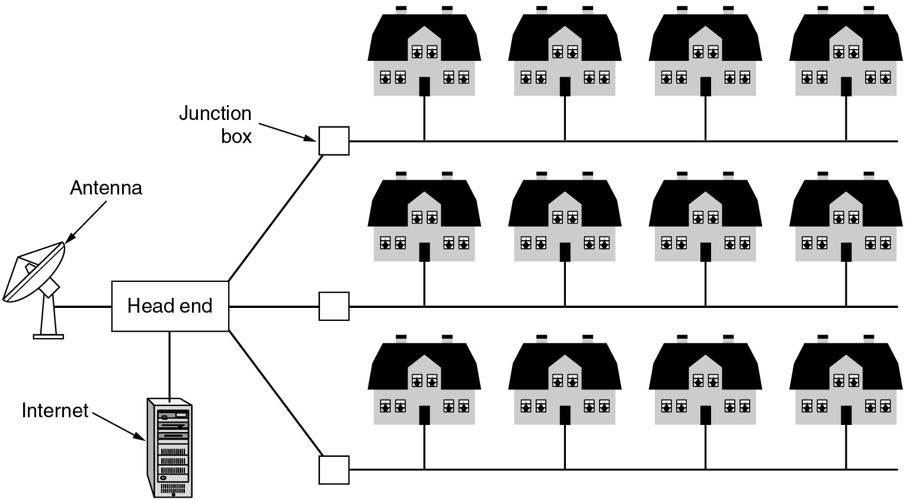
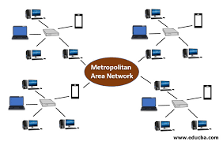
Metropolitan Area Network
Dr. UPPALAPATI SRILAKSHMI, Asst. Professor, Dept. of CSE, VFSTR Deemed to be University, E-mail: usl_cse@vignan.ac.in

Slide 19
MAN is basically a bigger version of a LAN and normally uses similar technology.
• It might cover a group of near by offices, may be either private or public.
• A MAN just has one or two cables and does mot have any switching elements.
• The main reason for even distinguishing MAN’s is that a standard has been adopted and this standard is now being implemented.
• It is called DQDB (distributed queue dual bus, 802.6).
DQDB consists of two unidirectional buses to which all computers are connected.
Each bus has head end.
A device that initiates transmission activity.
The key aspect of MAN is a broadcast medium to which all computers are attached.
Dr. UPPALAPATI SRILAKSHMI, Asst. Professor, Dept. of CSE, VFSTR Deemed to be University, E-mail: usl_cse@vignan.ac.in

Slide 20
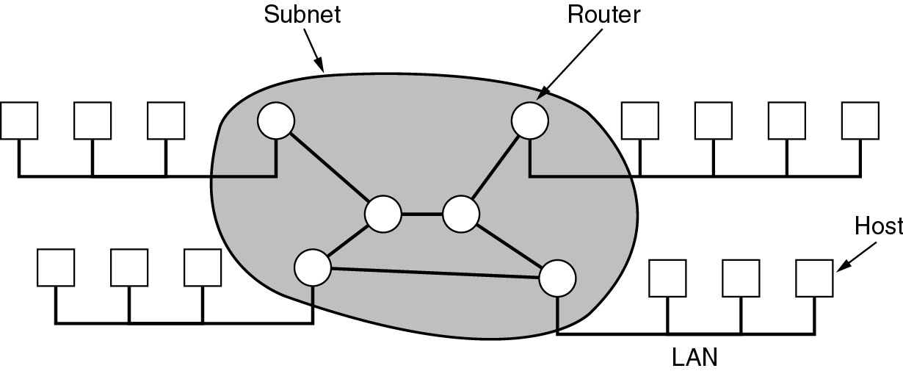
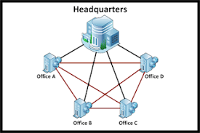
Wide Area Network
Relation between hosts on LANs and the subnet.
A stream of packets from sender to receiver.
Dr. UPPALAPATI SRILAKSHMI, Asst. Professor, Dept. of CSE, VFSTR Deemed to be University, E-mail: usl_cse@vignan.ac.in

Slide 21
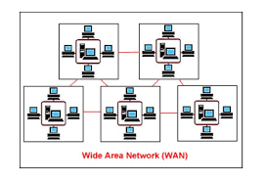
WANs spans a large geographical area, often a country or continent.
It contains collection of machines for running user applications, called hosts or end user.
The hosts are connected by communication subnet or subnet. The subnet carries message from host to host.
For communication aspect – subnet application aspect - hosts
Dr. UPPALAPATI SRILAKSHMI, Asst. Professor, Dept. of CSE, VFSTR Deemed to be University, E-mail: usl_cse@vignan.ac.in

Slide 22
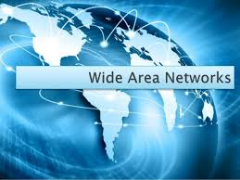
In WAN the subnets consists of two distinct components: transmission lines and switching elements.
• Transmission lines are circuits or channels
• Switching elements are specialized computers used to connect two or more transmission lines. These are called routers
• Each host is connected to LAN on which a router is present, or in some cases host can be connected directly connected to router.
• The collection of communication lines and routers form the subnet.
• If two routers do not share a cable or not wish to communicate , they must do this indirectly i.e., via other router.
Dr. UPPALAPATI SRILAKSHMI, Asst. Professor, Dept. of CSE, VFSTR Deemed to be University, E-mail: usl_cse@vignan.ac.in

Slide 23
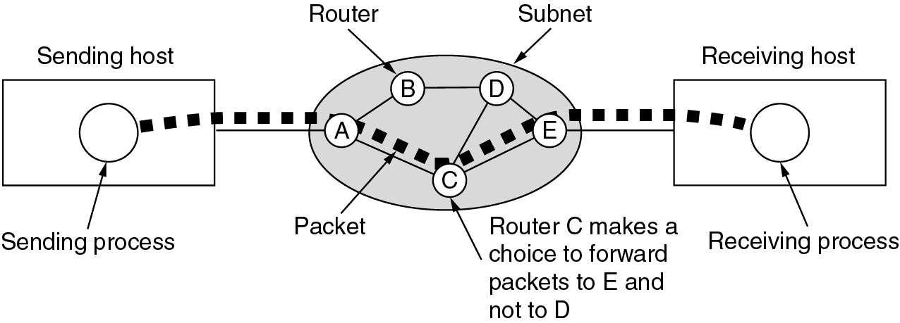
When the packet is send from one router to another via one or more intermediate routers , the packet is received at each router and stores until required output line is free and then forward.
A subnet using this principle is called point-to-point , store- and-forward, or packet-switching subnet.
Dr. UPPALAPATI SRILAKSHMI, Asst. Professor, Dept. of CSE, VFSTR Deemed to be University, E-mail: usl_cse@vignan.ac.in

Slide 24
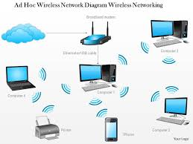
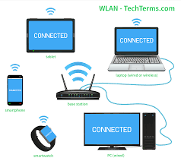
Wireless Networks
Categories of wireless networks:
System interconnection
Wireless LANs
Wireless WANs
Dr. UPPALAPATI SRILAKSHMI, Asst. Professor, Dept. of CSE, VFSTR Deemed to be University, E-mail: usl_cse@vignan.ac.in

Slide 25
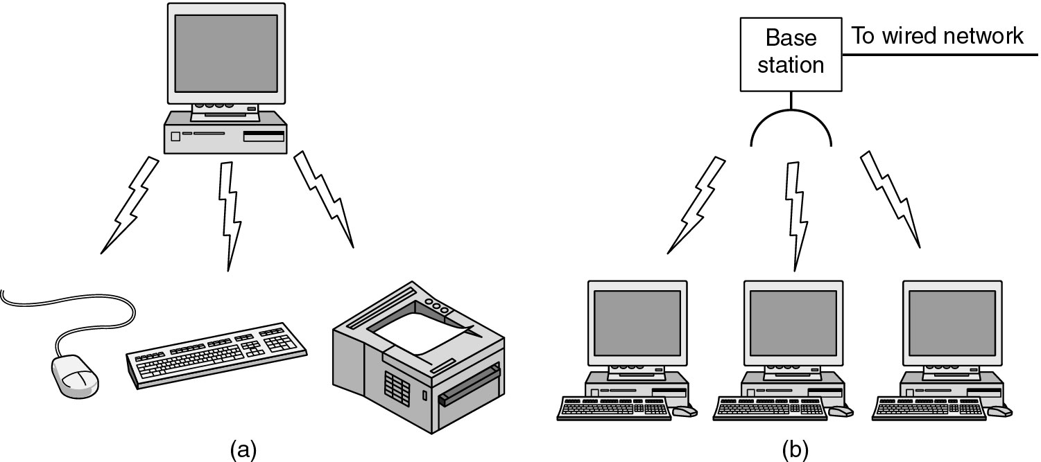
Wireless Networks
(a) Bluetooth configuration
(b) Wireless LAN
Dr. UPPALAPATI SRILAKSHMI, Asst. Professor, Dept. of CSE, VFSTR Deemed to be University, E-mail: usl_cse@vignan.ac.in

Slide 26
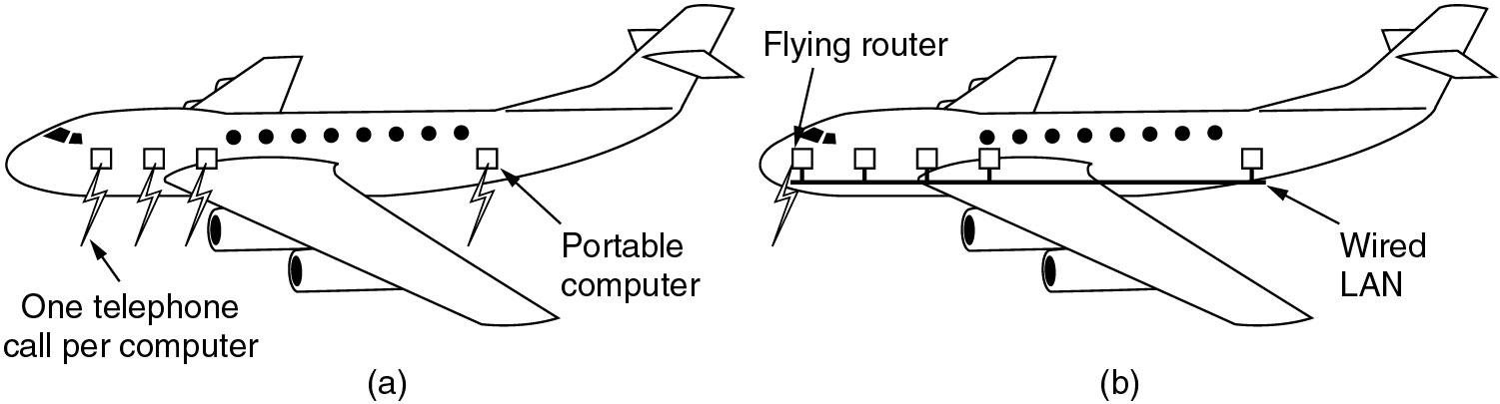
Wireless Networks
(a) Individual Mobile Computers
(b) A Flying LAN
Dr. UPPALAPATI SRILAKSHMI, Asst. Professor, Dept. of CSE, VFSTR Deemed to be University, E-mail: usl_cse@vignan.ac.in

Slide 27
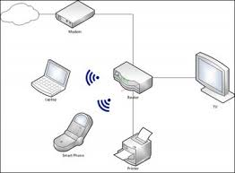
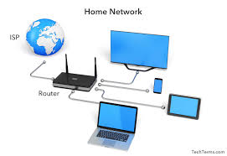
Home Networks
Computers (desktop PC, PDA, shared peripherals
Entertainment (TV, DVD, VCR, camera, stereo, MP3)
Telecomm (telephone, cell phone, intercom, fax)
Appliances (microwave, fridge, clock, furnace, airco)
Telemetry (utility meter, burglar alarm, bodycam).
Dr. UPPALAPATI SRILAKSHMI, Asst. Professor, Dept. of CSE, VFSTR Deemed to be University, E-mail: usl_cse@vignan.ac.in

Slide 28
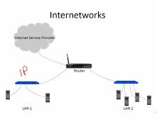
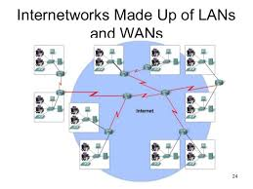
Internetworks
Connect multiple networks of one or more organizations into a large, uniform communication system.
The resulting system is called an Internetwork or Internet.
Dr. UPPALAPATI SRILAKSHMI, Asst. Professor, Dept. of CSE, VFSTR Deemed to be University, E-mail: usl_cse@vignan.ac.in

Slide 29
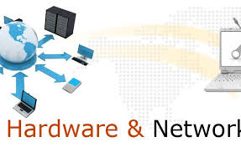
SUMMARY
Networking hardware, also known as network equipment or computer networking devices, are electronic devices which are required for communication and interaction between devices on a computer network.
Components of Network Hardware Devices are:
NIC, HUB, Switch, Router, Gateway and Modem.
Types of Networks are:
LAN, MAN, WAN, Wireless Networks, Home Networks and Internetworks.
Dr. UPPALAPATI SRILAKSHMI, Asst. Professor, Dept. of CSE, VFSTR Deemed to be University, E-mail: usl_cse@vignan.ac.in

Slide 30
THANKS!
Any questions?

